Slide 1

Airline Fatalities
created by: Aarti Ramani
created on: 7/2/2023

Slide 2
Introduction
Ensuring airline safety has always been a top priority for airlines. Passenger air travel can be a source of panic due to the unfortunate and sometimes fatal occurrence of airline crashes. It is imperative to establish whether airline travel is genuinely hazardous or if incidents and fatalities were unavoidable occurrences, as safety concerns in air travel continue to escalate.
Metrics on airline safety were obtained by conducting an assessment of aviation safety and fatalities data from the Aviation Safety Network (airline safety) and airplane crashes from Kaggle.
The forthcoming slides present a range of critical factors and noteworthy observations.

Slide 3
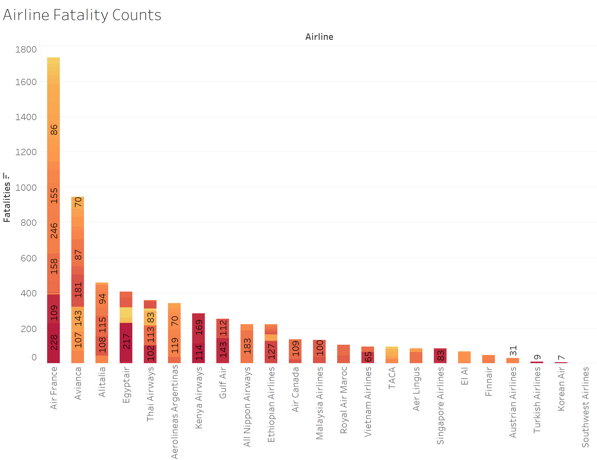
the objective of this chart is to determine which airline had the highest and lowest fatalities. additionally, this visualization shows the number of fatalities per year, which allows us to compare the increase/decrease in fatalities across years.
upon examining the chart, it is evident that Air France had the most fatalities.

Slide 4
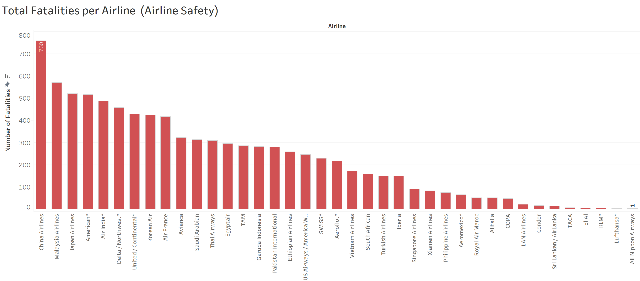
We can see from the chart, China Airlines reported the highest number of fatalities at 760, accounting for 8% of total fatalities during this period, followed by Malaysian Airlines and Japan Airlines. it's worth noting that the figures from airline safety data differ from the airline crash data available on Kaggle, (previous slide - #3).

Slide 5
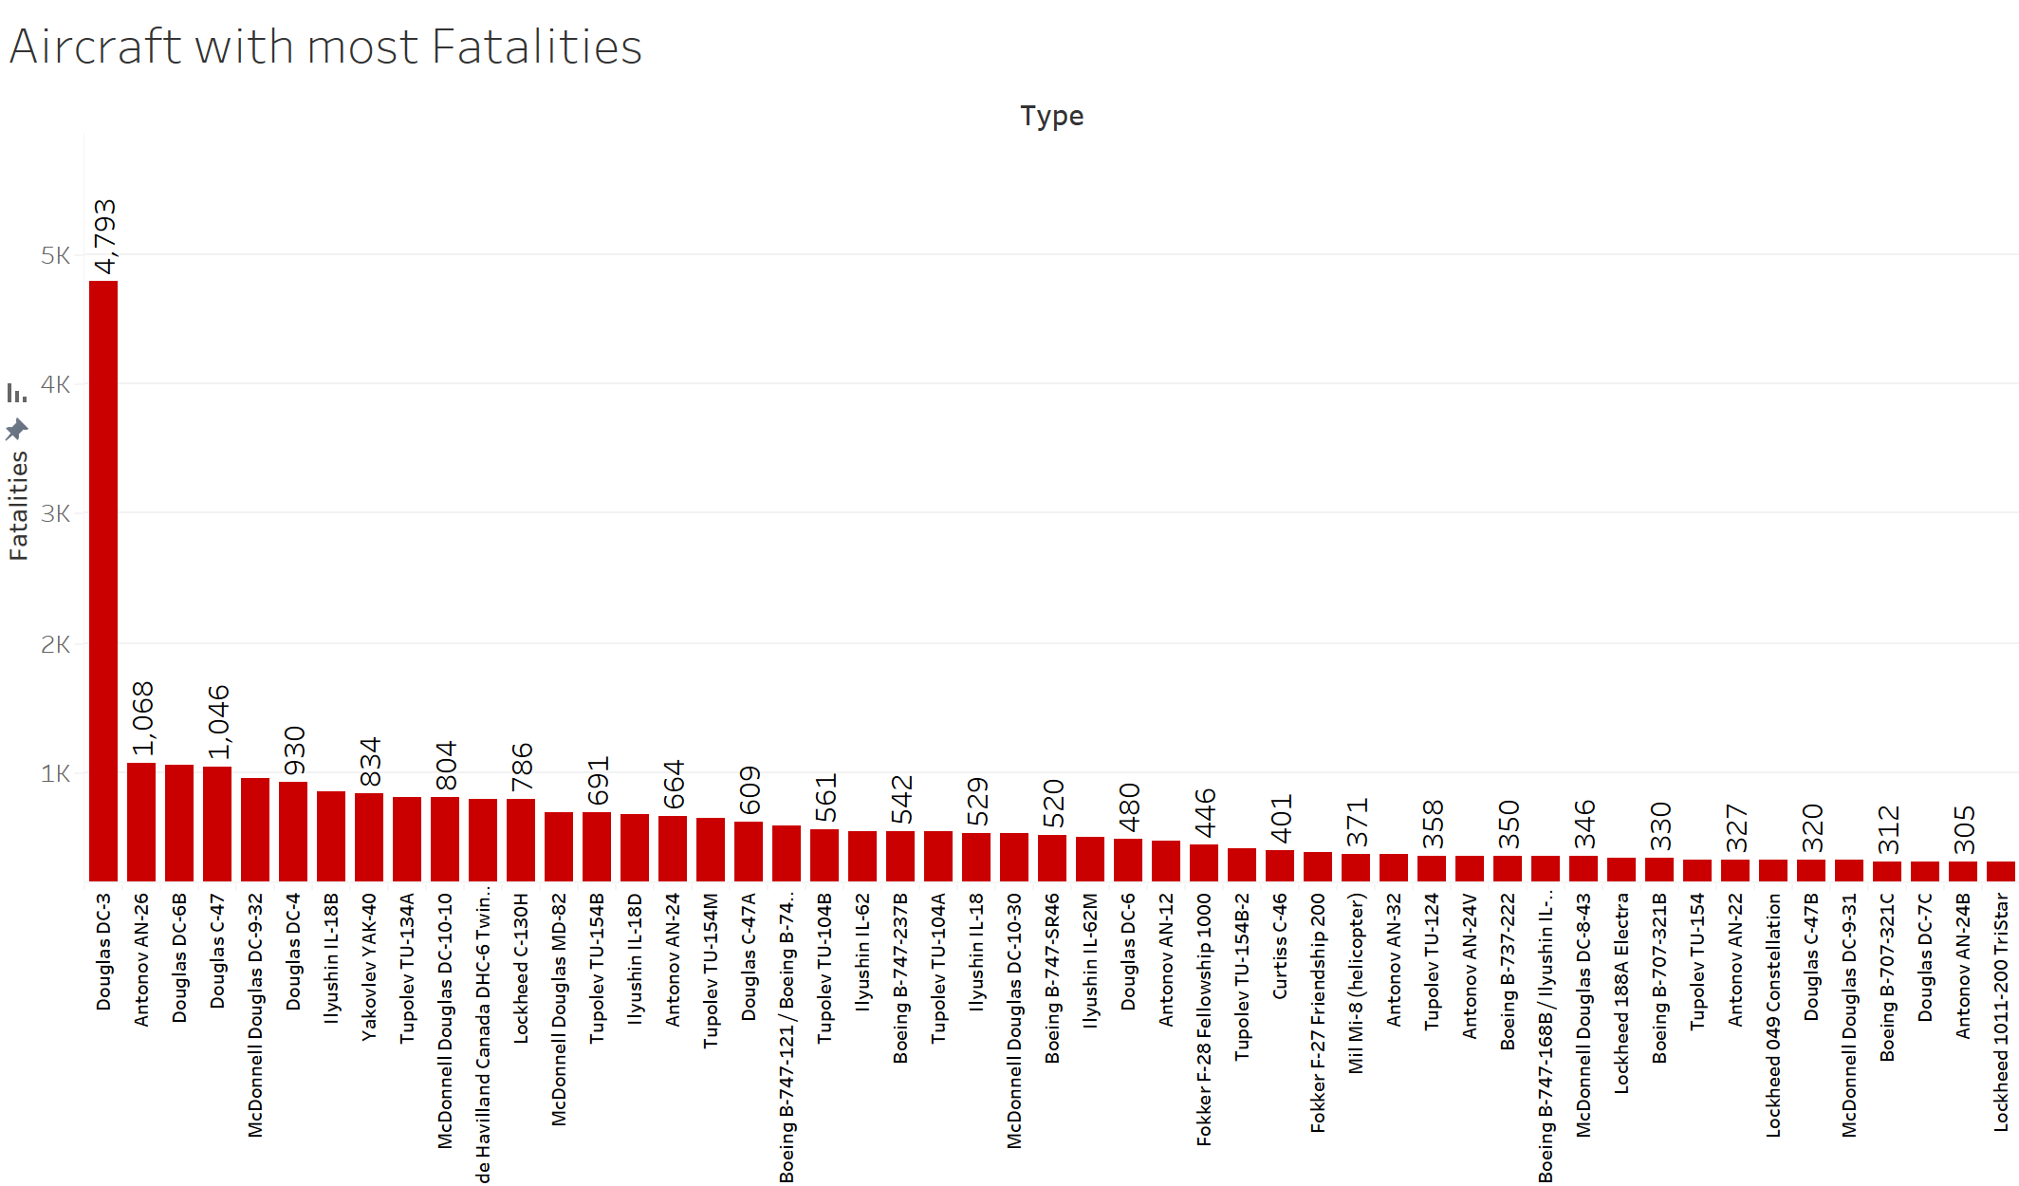
From the chart, it is evident that the Douglas DC-3 aircraft has the most fatalities with over 4000 fatalities.
This raises some serious safety concerns for the Douglas dc-3 aircraft.

Slide 6
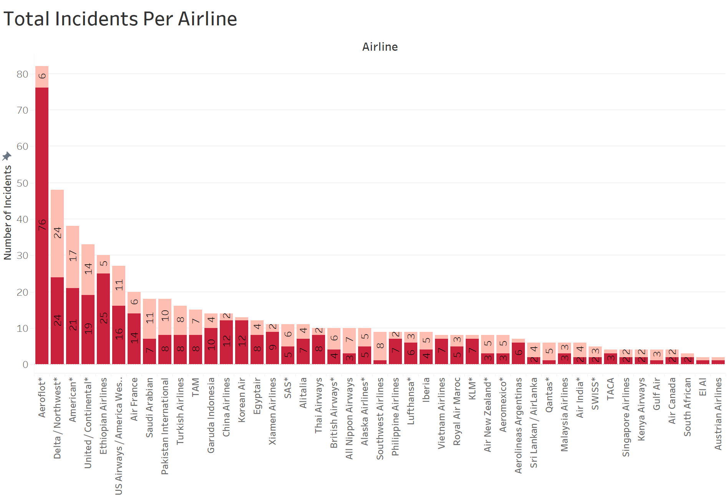
By examining the stacked bar chart, it is clear that Aeroflot* was responsible for most incidents.

Slide 7
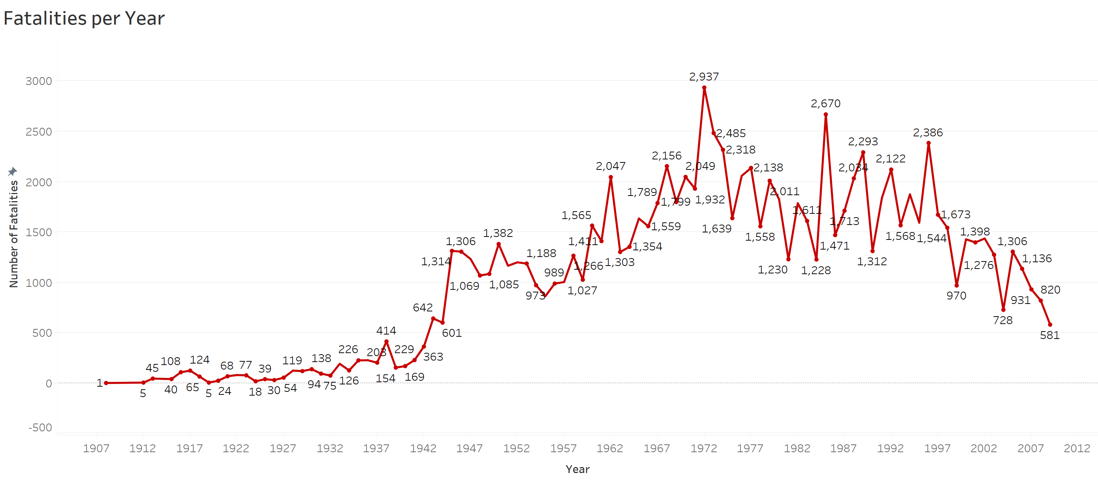
From the above chart, we can see that the number of Fatalities started trending down in 1999, falling by 40.10% (389) in 10 years.﻿ The number of Fatalities dropped from 970 to 581 during its steepest decline between 1999 and 2009.

Slide 8
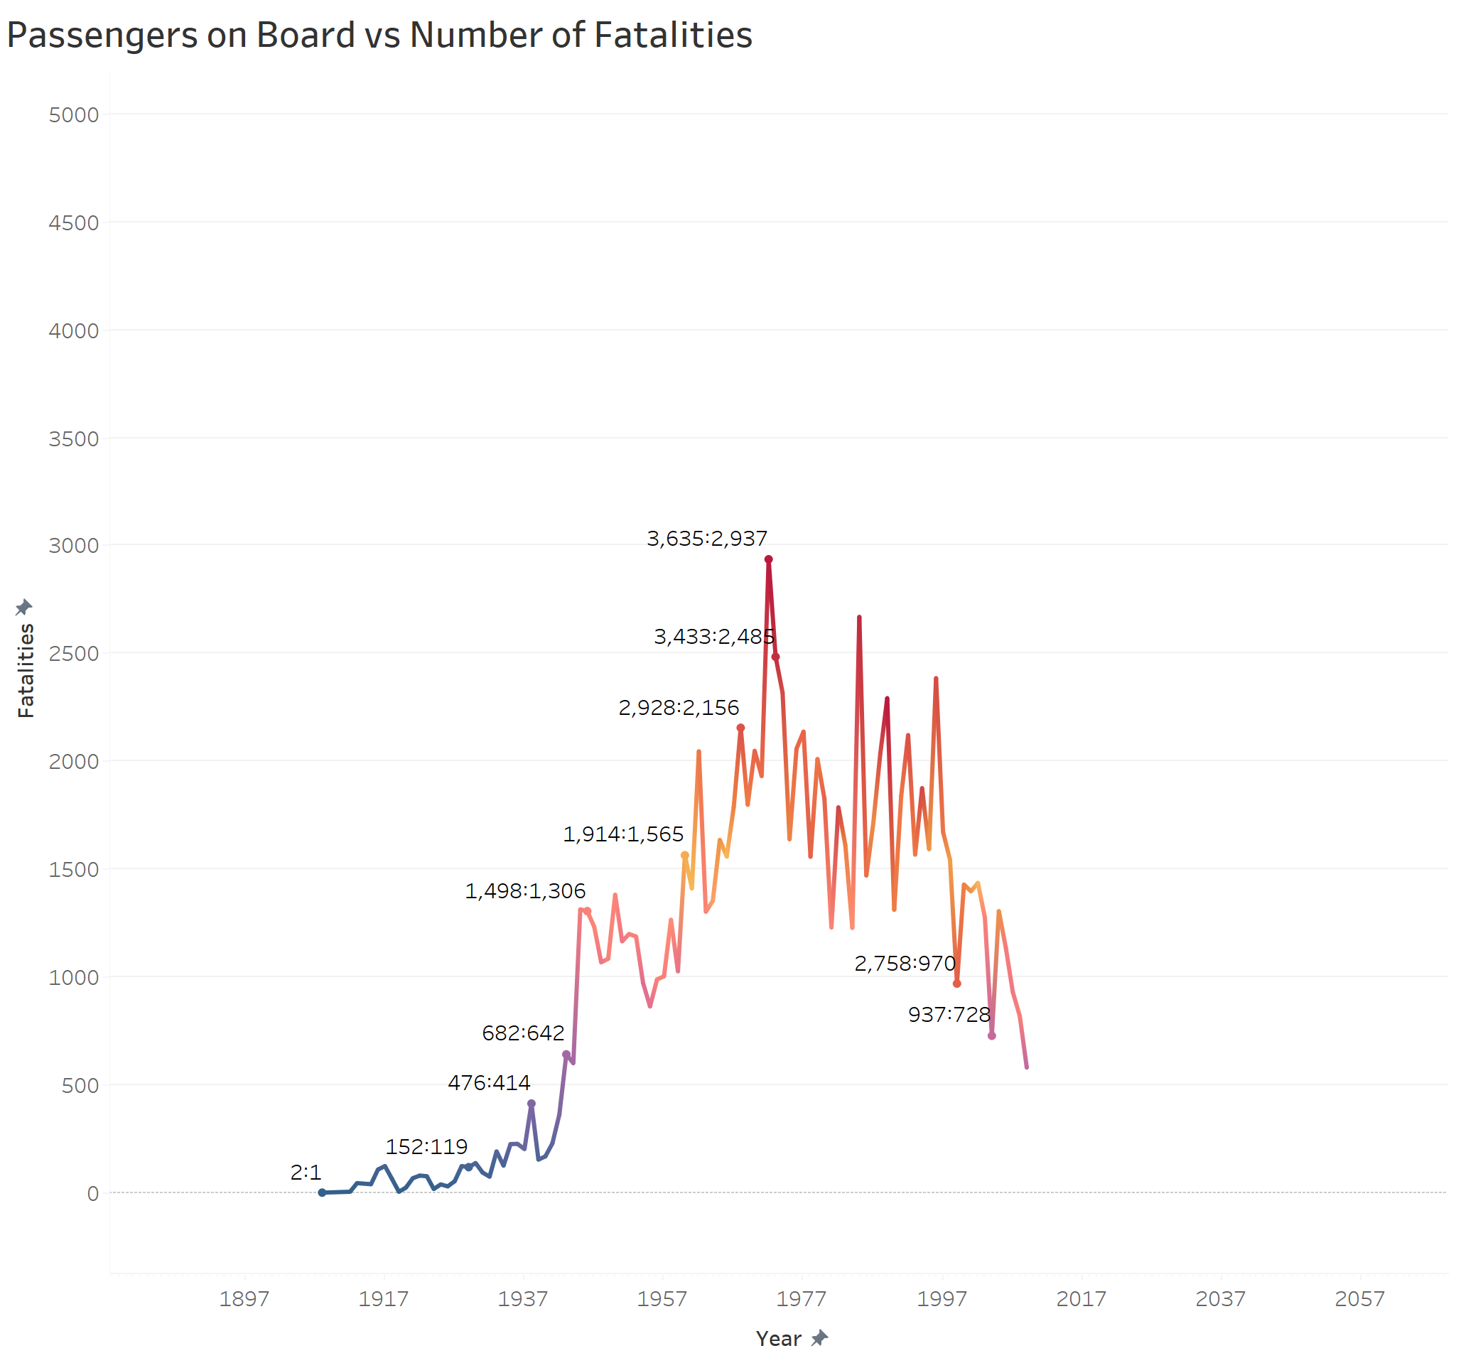
this chart helps determine the ratio of passengers on board to the number of fatalities. This visual representation will aid in assessing the nature of the fatalities and their effect on the number of passengers on board. One can conduct an analysis to determine the impact of passenger count and aircraft type, on airline safety and explore potential adjustments that may prevent crashes.

Slide 9
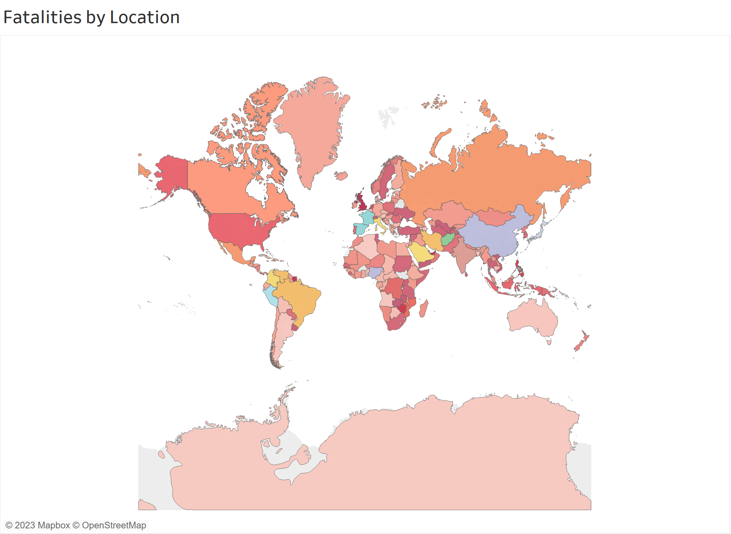
This map displays data based on longitude and latitude coordinates. The varying shades of red indicate the number of fatalities at the country level.

Slide 10
Summary
Although airline travel is reported to be unsafe, we can see that the trend in fatalities is declining. Implying airlines, particularly commercial airlines, are already taking necessary steps to ensure safety. It is also observed that the number of fatalities across top airlines is very low in comparison to low-cost airlines. This however does not imply that low-cost airlines are unsafe.
Recommendations
There are a few aircraft types that have more fatalities than others. Further analysis is required to identify if this is truly an aircraft issue or if other factors such as weather/location contribute to the fatalities. If this happens to be an aircraft issue, airlines need to work with the aircraft manufacturer to ensure safety measures are established and the same needs to be communicated to all airlines.

Slide 11
Questions?
DATA SOURCES:
Airplane crashes 1908-2009 - dataset by hhaveliw. data.world. (2018, July 12). https://data.world/hhaveliw/airplane-crashes-1908-2009
Fivethirtyeight. (n.d.). Data/airline-safety at master · fivethirtyeight/data. GitHub. https://github.com/fivethirtyeight/data/tree/master/airline-safety

Slide 12
THANK YOU!!

